Slide 1
Quantum processors and computing

Slide 2
What Is Quantum Computing in Simplest Terms?
Quantum computing relates to computing made by a quantum computer. Compared to traditional computing done by a classical computer, a quantum computer should be able to store much more information and operate with more efficient algorithms. This translates to solving extremely complex tasks faster.

Slide 3
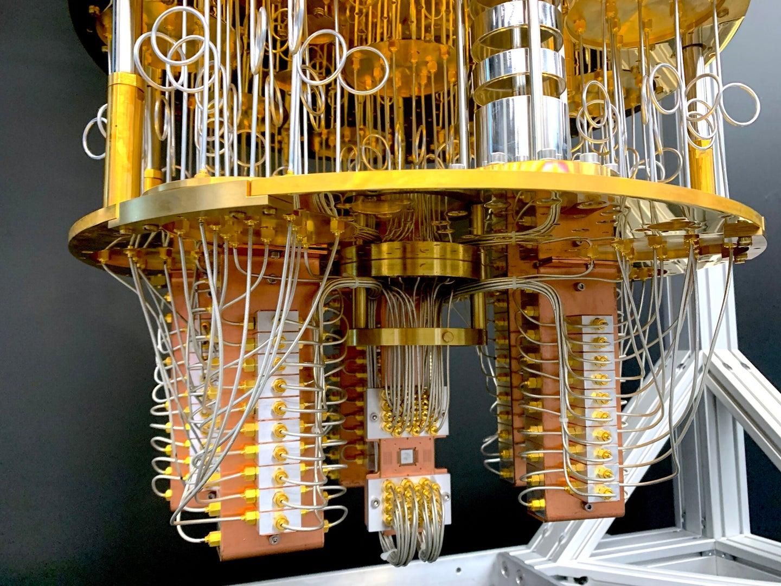

Slide 4
What Is Quantum Computing?
Quantum computing is an area of computer science that uses the principles of quantum theory. Quantum theory explains the behaviour of energy and material on the atomic and subatomic levels.
Quantum computing uses subatomic particles, such as electrons or photons. Quantum bits, or qubits, allow these particles to exist in more than one state (i.e., 1 and 0) at the same time.
Quantum computing has the capability to sift through huge numbers of possibilities and extract potential solutions to complex problems and challenges.

Slide 5
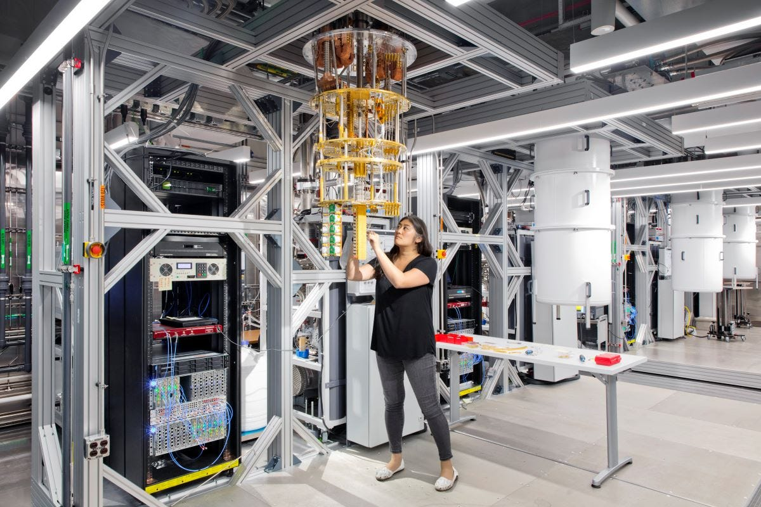

Slide 6
Uses and Benefits of Quantum Computing
Financial institutions may be able to use quantum computing to design more effective and efficient investment portfolios for retail and institutional clients. They could focus on creating better trading simulators and improving fraud detection.
The healthcare industry could use quantum computing to develop new drugs and genetically-targeted medical care. It could also power more advanced DNA research.
For stronger online security, quantum computing can help design better data encryption and ways to use light signals to detect intruders in the system.
Quantum computing can be used to design more efficient, safer aircraft and traffic planning systems.

Slide 7
Quantum Computers In Development
Google
Google is spending billions of dollars to build its quantum computer by 2029. The company opened a campus in California called Google AI to help it meet this goal. Once developed, Google could launch a quantum computing service via the cloud
IBM
IBM plans to have a 1,000-qubit quantum computer in place by 2023. For now, IBM allows access to its machines for those research organizations, universities, and laboratories that are part of its Quantum Network.

